Slide 1

Module 2 -
PDM System Training

Slide 2
Course contents
Agenda
Goals
Introduction
Terminology
Business process using PDM
Exercises
Summary
Questions and comments
Closing

Slide 3
Goals of this course
Familiarize trainees with the application window
Familiarize trainees with basic features and buttons
Instruct trainees to use System Help as training material
After this course trainee is ready to participate on a PMD engineering course

Slide 4
Introduction
You need only login and password to PDM and connection to Metsonet
PDM system works through a internet browser (IE 5.5 or higher)

Slide 5
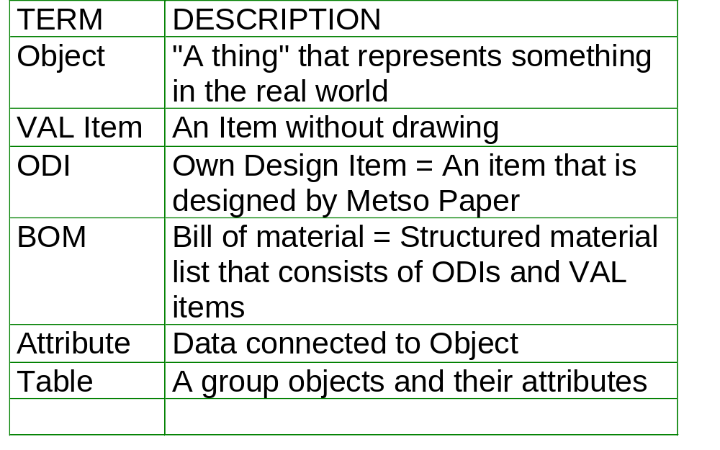
Terminology
More terms in Terminology -database on raun06

Slide 6
Business process using PDM
Technical Specification
EDM to PCS
Mass Printing of Drawings
Initial Data
Planned Purchase Orders
ESM
Checking Translations
ESM
Update Models
ESM
Item
ESM,BRP
Printing Customer BoMs
DSM
Create Delivery
Drawing
ESM
Revisioning
LSM
Create Order lists
Drawing to Archives
ESM,DSM
Engineering Internal Changes
ESM
Model Selection
ESM
BoM
ESM
Adding Initial Values
Model Selection
ESM
Spare Part Information
Engineering
ESM
Copying Model to
Delivery
ESM
Marking Customer BoMs
ESM
Item
ESM
Transfer to Order List
Drawing
ESM
Copying to EDM
Drawing to Archives
EDM to PCS
ESM
Critical Purchases
PDM
BoM
PRP
Handled with Other System
ESM
Transfer to Order List
ESM,LSM
Following the Purchases
Copying to EDM
ESM,LWD
Viewing the Drawings

Slide 7
Business process using PDM
Specify Search
Criteria
Select Type
for Commercial
Item
Login
Search
Commercial
Items
View
Commercial
Items
Select Title
for Commercial
Item

Slide 8
Business process using PDM
Select Table for
Commercial
Items
Sort
Commercial
Items
View
Commercial
Items
View
Related
Spare Parts
View
Commercial
Item Data
View
Standard or
Manufacturer
View
Extra
Lanquages

Slide 9
Business process using PDM
View STD/
Manufacturer
Search STD /
Manufacturers
View STD/
Manufacturer
Data

Slide 10
Summary
Bule bule

Slide 11
Questions & Comments
Any questions or comments?

